Slide 1

Oracle PL/SQL for an Online Bookstore
Database Implementation

Slide 2

ABOUT US
Book Haven is an online bookstore offering a diverse selection of books, a user-friendly interface, personalized recommendations, secure shopping, and a strong focus on customer satisfaction.
Book Haven sells a variety of books, manages customer orders, and maintains information about book publishers. We will create four tables: Books, Customers, Orders, and Publishers.

Slide 3

01
Create tables with primary key and foreign key constraints having auto-increment sequences for one of the tables.

Slide 4
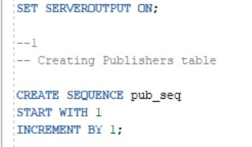
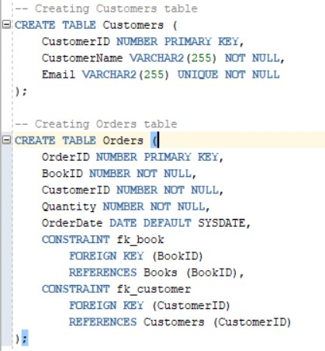
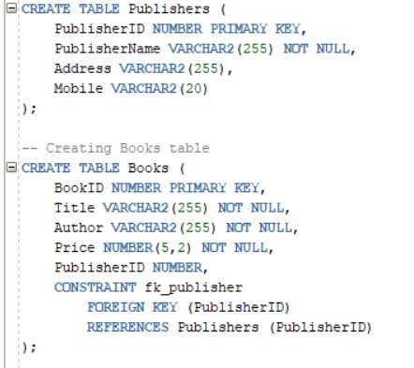
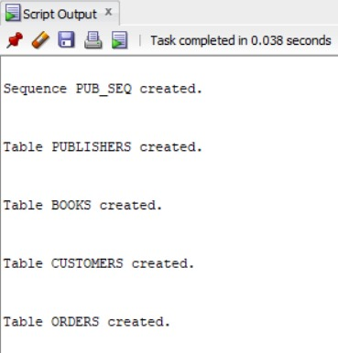

Create tables with primary key and foreign key constraints having auto-increment sequences for one of the tables.
Use Sequence
Create table Customers & Orders
Create table Publishers & Books
OUTPUT

Slide 5

02
Insert a set of matching records for the above tables.

Slide 6

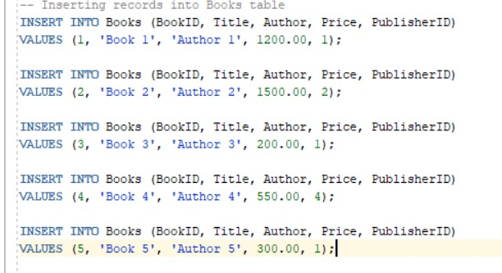
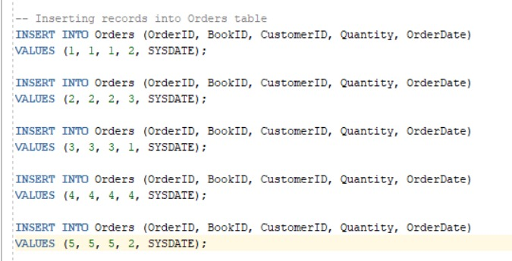
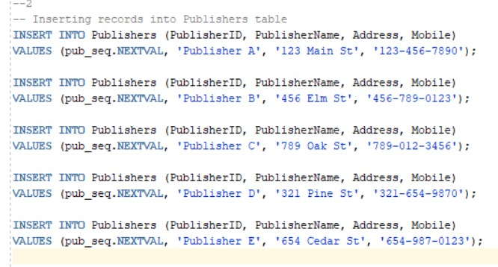
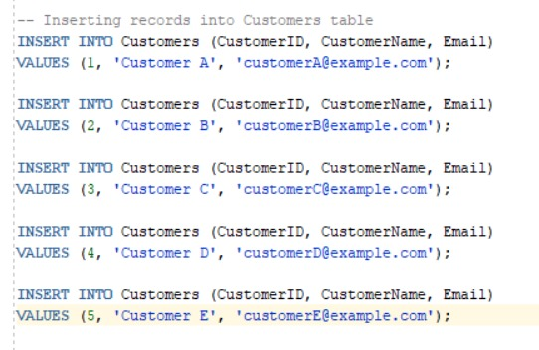
Insert a set of matching records for the above tables.
Insert data into Books
Insert data into Orders
Insert data into Publishers
Insert data into Customers

Slide 7
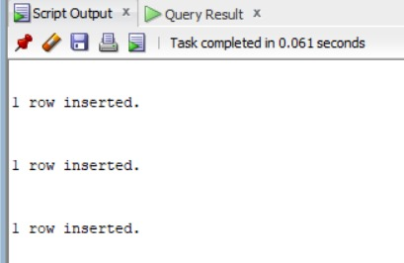
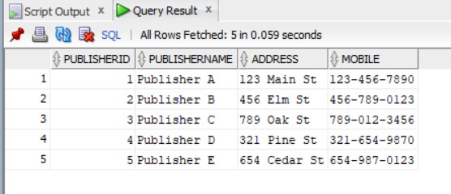
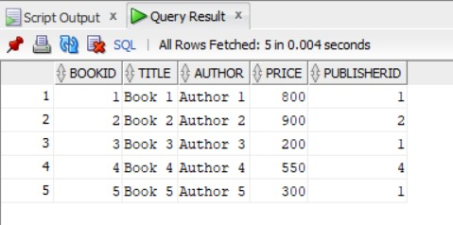
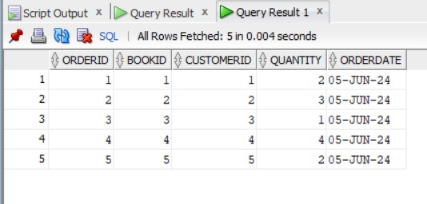
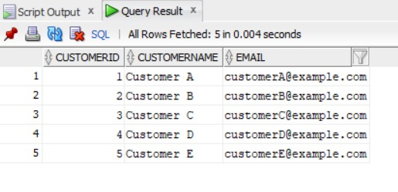
Inserted data into Publishers
Inserted data into Books
Inserted data into Orders
Inserted data into Customers

Slide 8

Write any three select queries using where, group by, having, and order by.
03

Slide 9


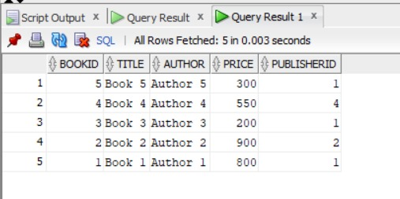
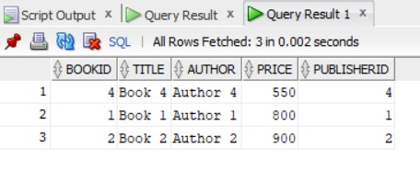
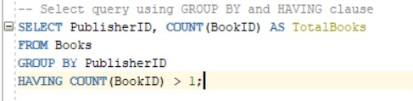

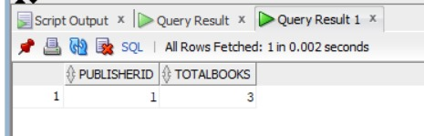
Write any three select queries using where, group by, having, and order by.

Slide 10

Write a single-row and multiple-row subquery using the above tables.
04

Slide 11
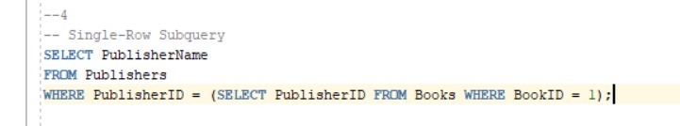
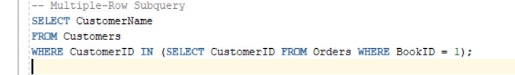
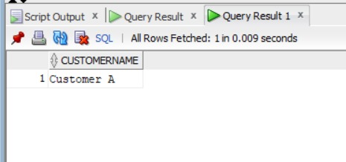
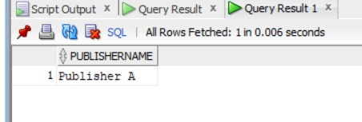
Write a single-row and multiple-row subquery using the above tables.

Slide 12
05
Create a PL/SQL block that contains a Cursor. It must have a LOOP and a suitable cursor attribute

Slide 13
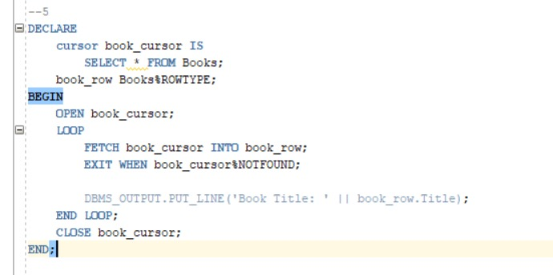
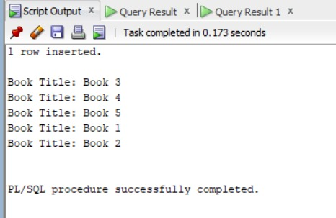
Create a PL/SQL block that contains a Cursor. It must have a LOOP and a suitable cursor attribute

Slide 14
06
Create a view using one of the tables created.

Slide 15
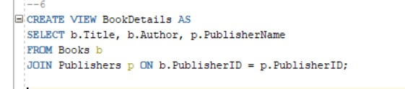
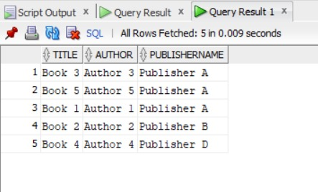
Create a view using one of the tables created.

Slide 16
Write a PL/ SQL block to retrieve a record for specific input.
07

Slide 17
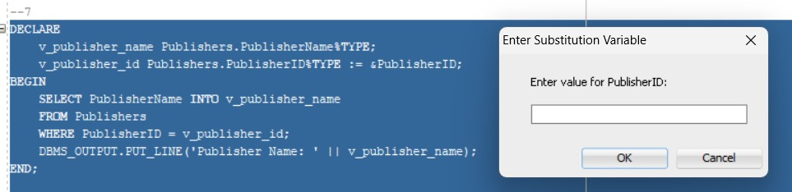

Write a PL/ SQL block to retrieve a record for specific input.

Slide 18
Write a PL/ SQL block to update a record for specific input.
08

Slide 19
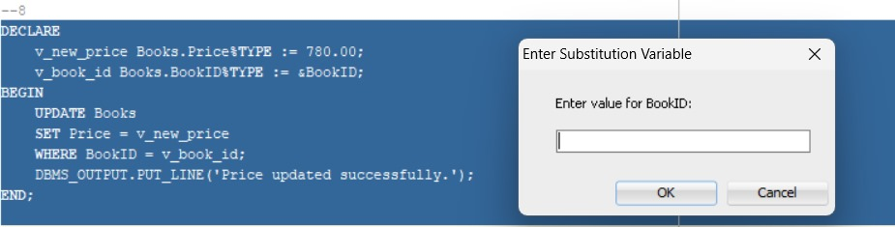

Write a PL/ SQL block to update a record for specific input.

Slide 20
09
Write a PL/ SQL block to delete a record for specific input.

Slide 21
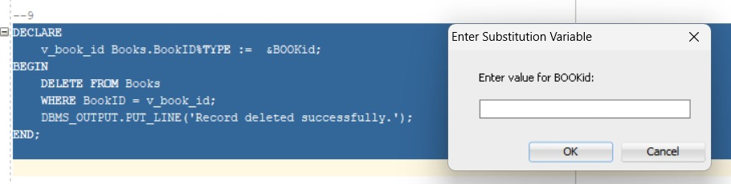
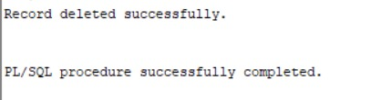
Write a PL/ SQL block to delete a record for specific input.

Slide 22
10
Modify the above query to display the number of rows deleted.

Slide 23
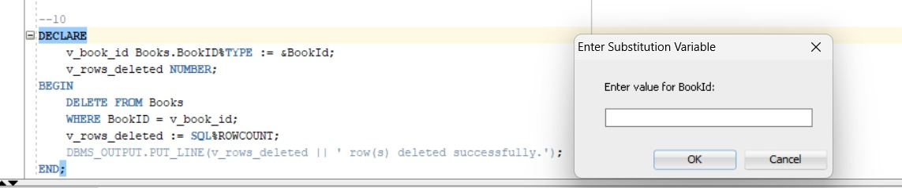
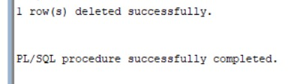
Modify the above query to display the number of rows deleted.

Slide 24
Thank You !
COHNDSE233F – 019
COHNDSE233F - 020
COHNDSE233F - 021
COHNDSE233F – 022
COHNDSE233F - 023

